Slide 1
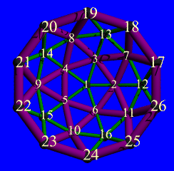
Buckminster | Component Assembly Project
A subproject of the Eclipse Technology Project

Slide 2
Problems?

Slide 3

GrowingPains Inc. – Starting out
Startup – financing completed!
Team starts coding
  Code base is small
  All know whole system
  Building is easy & fast
  Communication is easy & ad hoc
  Only one configuration
High pressure to reach the market in time!

Slide 4

GrowingPains Inc. – Leveling out
Success – v1 out the door after 6 months!
Team expands to build v2 and maintain v1
  Code base grows
  Harder to know whole system
  Building is somewhat complex and buildtimes go up
  Communication must be more formal and less ad hoc
  # of supported cfgs/variations increases
High pressure to timely fulfill market expectations!

Slide 5
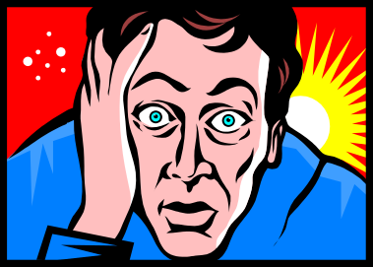
GrowingPains Inc. – Strain starts to tell
Success – v2 out the door after another 18 months!
Team expands and becomes physically distributed to maintain v1/v2, and laterally expand the market to new cfgs/variations based on v2
  Code base grows really big
  Product portfolio expands
  Impossible to know whole system
  Building is a black art; full builds take looong
  Communication is hard, esp. given time zone diff:s
  # of supported cfgs/variations increases exponentially
  New hires have a hard time becoming productive
  Many unnecessary ’non-problems’
High pressure to follow up market success!

Slide 6

GrowingPains Inc. - Victims of success?
The situation is understandable, but really requires addressing
So, what’s to be done?
Many issues, so presently we’ll focus around monolith codebase related issues

Slide 7
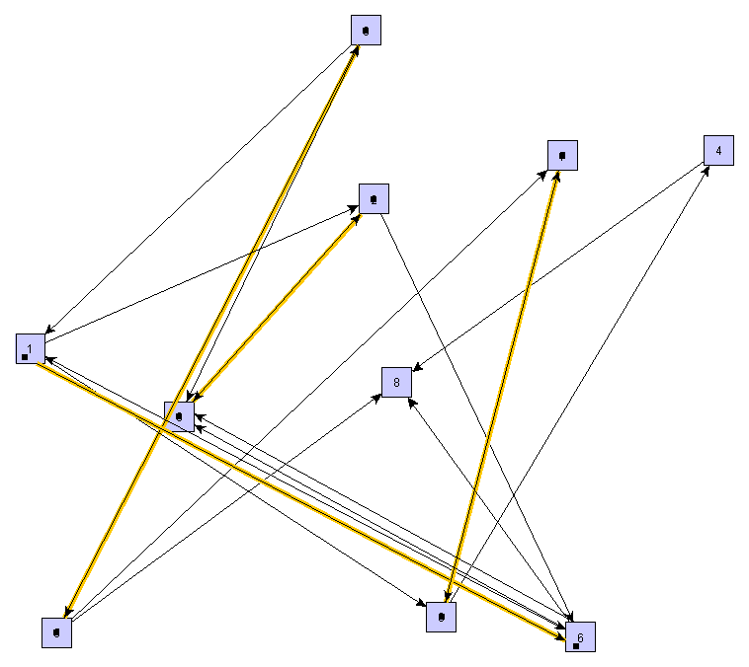
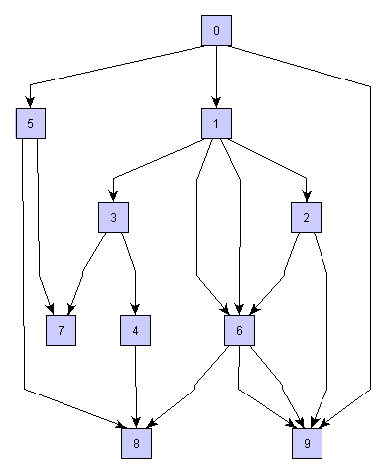
Straightening out the kinks

Slide 8
The componentized monolith
A new & better monolith can be arrived at
  It is generally a necessary first step
  But, will only scale a finite amount better
Regardless, there are some definite benefits:
  Clearer separation of concern
  Responsibility can be disseminated among persons/groups
  Software architecture can be made clearer
    For example, by separating external from internal API

Slide 9
Component hierarchy becomes an important topic
For example, no circular dependencies allowed!
  Impossible to calculate build order
  Java allows it because the compiler handles it, but you can’t create regular makefiles for it. May be acceptable internally for a component though.
A monolith lacks some flexibility
  What to do if a variant is needed where only a single subsystem is upgraded?
    The general problem is clear: how to describe a configuration with both ’what components’ and ’what versions of those components’. Then, how are such configurations materialized to disk (from potentially several sources).

Slide 10
Sample scalability issue...
Build times does not necessarily improve; in fact, it can get worse!
  Builds are still made begin-to-end each time
  Due to otherwise improved structuring, a componentized build script might perform worse*
/
makefile
/
makefile
a
makefile
...
...
b
...
makefile
...
* ”Recursive Make Considered Harmful” (http://aegis.sourceforge.net/auug97.pdf)

Slide 11

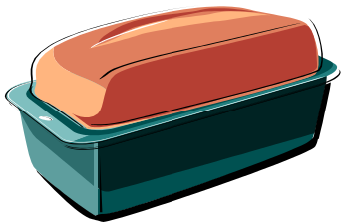
Common solution:
Replace source with prebuilt libraries
Good solution, but generally has some weaknesses
  requires management and tool support to ensure correctness
  is difficult when you need to run with the source for debugging purposes (what source corresponds to what binary, what changes are needed in make files to dynamically adjust to etc)
A tool solution needs to be able to dynamically use rules to switch between one form or another, often according to user intentions, and transparently propagate knowledge between otherwise ignorant components

Slide 12


The consumer/producer problem
Small/smooth movements at the (producer) base translate to wild/jerky motion at the (consumer) end!
...compare to a whip:
...or a car convoy:

Slide 13
So, producers are frequently driving the rate of change
Which means consumers:
  has a hard time to influence timing
  frequently has to work in an unstable environment
Consumers may not be able to control the rate of change...but they should have control of accepting changes at their own rate. More power to the consumer!

Slide 14
Separation achieved but needs to be maintained
Beware: developer inventiveness and time pressure can quickly erode componentization
Cheats can go undetected a long time (and, you can be sure they will rear their heads at the most inopportune moment...)
Actually, it’s sometimes ok to cheat, but it should be:
  Harder to do casually
  More visible
  More localized

Slide 15
Componentizing is good, but a monolith is still a monolith...
Next step!

Slide 16
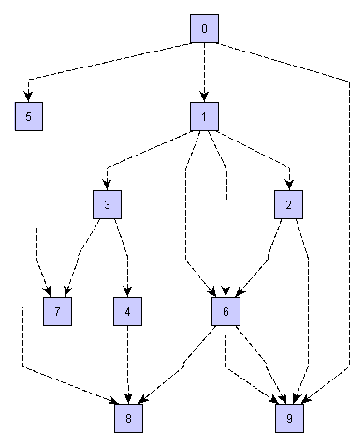
Divide & Conquer!

Slide 17
Increase reusability opportunities!
Component FOO
Apply OO principles on several levels
Data hiding, encapsulation, abstractness
  Encourages separation of concern
  Encourages interface & implementation splits
  Encourages looser coupling
  Encourages better design mapping
Explicit component dependencies more visible
  Helps with impact analysis
Enables higher parallelism
Clearer areas of responsibility
Depends on A,B,C
Public bin layout
Private src layout

Slide 18
Some assembly required, though
New/adapted tools & processes – sample issues:
  Components have individual life cycles (but pay attention to what co-varies and avoid incorrect componentization)
  Impacts how Configuration Management/Version Control is performed
  Keep track of configurations (components/versions, dependencies)
  A generic build initiation framework understanding piece-by-piece builds, combine builds, persisted intermediate results etc
Systems & people must ’talk’ using the same terminology
A fair amount of admin/management/development/maintenance
Must be open enough to wrap an existing environment before progress can be made

Slide 19
Solution?
Buckminster overview

Slide 20
Summary
The Buckminster high-level definition statement:
  Buckminster addresses development problems associated with assembling complex component structures in team-based development
Buckminster makes use of, and leverages, Eclipse and its architecture/framework. Works as both a fully integrated UI in the IDE, but also as a freestanding (command-line) executable environment.
Project name: after Buckminster Fuller, architect, engineer; inventor of the geodesic dome; pioneer of manufactured modular structures.
  “When I'm working on a problem, I never think about beauty. I think only how to solve the problem. But when I have finished, if the solution is not beautiful, I know it is wrong.”
    R. Buckminster Fuller
    US architect & engineer (1895 - 1983)

Slide 21
Key objectives
Buckminster’s primary objective is to leverage & extend Eclipse to:
  bring complex component development on par with current mechanisms for plug-in & feature development
  extend the component dependency model to allow materialization based on match rules
Buckminster will accomplish this by:
  introducing a project/component-agnostic way of describing arbitrarily complex component structures and dependencies in development projects
  allowing component materialization based on match rules, i.e.similar to platform mechanism for runtime resolution of plug-ins/features
  providing a materialization mechanism that handles all component types referenced through repository handlers

Slide 22
Features
Buckminster currently includes:
  Complex dependency resolution
  Uniform component dependency formats
  Intelligent retrieval mechanisms
Buckminster is itself componentized and has several possibilities of being extended easily (through the generic Eclipse ’extension point’ mechanism).

Slide 23
Drill-down: Complex dependency resolution
Provides recursive resolution of dependencies
Supports a variety of versioning schemes
Applicable to source and binary artifacts that are not version-controlled in a traditional sense
Uses match rules similar to those in the Eclipse plug-in runtime framework, eventually allowing comparison of current and prior dependency resolutions to support update impact analyses

Slide 24
Drill-down: Uniform component dependency format
Component-type agnostic mechanism for describing components and their respective targets and dependency requirements
Will leverage dependency info associated with typical Eclipse projects and range of other component types
Extensible to provide additional strategies for dependency pattern recognition

Slide 25
Drill-down: Intelligent retrieval mechanisms
Separating the bill of material needed for a given configuration from its actual materialization
Separation is of value since:
  dependencies may appoint software that is locally installed on one machine but lacking on another
  bills of materials may be shared between team members, while materialization info may vary
  information about repositories will be abstracted out in order to provide site and repository transparency

Slide 26
Demos
Buckminster in action

Slide 27
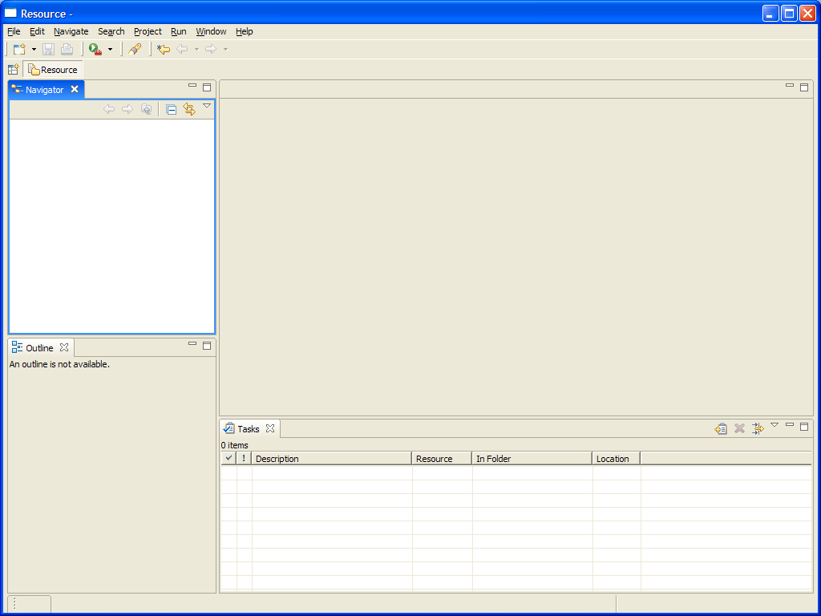
Buckminster in action – sample scenario (1)
Scenario: ’I want to write code for Buckminster’
  Fire up Eclipse

Slide 28
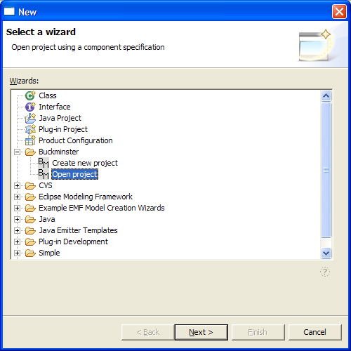
Buckminster in action – sample scenario (2)
Use the ’Open Project’ Wizard

Slide 29
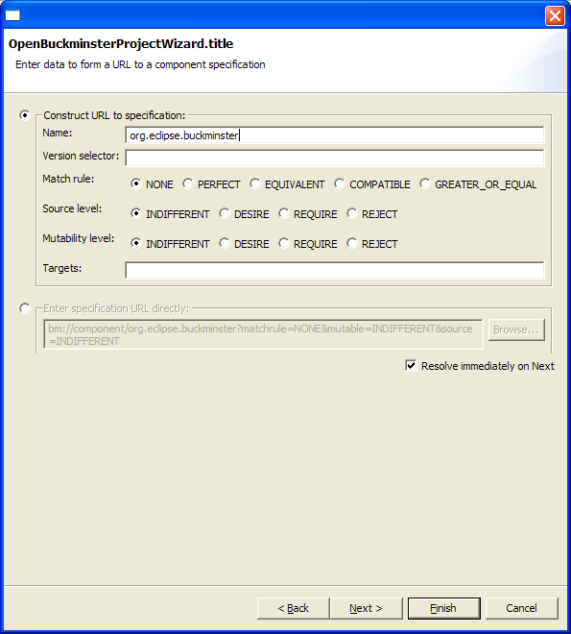
Buckminster in action – sample scenario (3)
Enter the ’known’ entrypoint
  org.eclipse.buckminster
With the given component name, the resolver can figure out in what repository it should look.
  Either press Finish outright, or use Next...

Slide 30
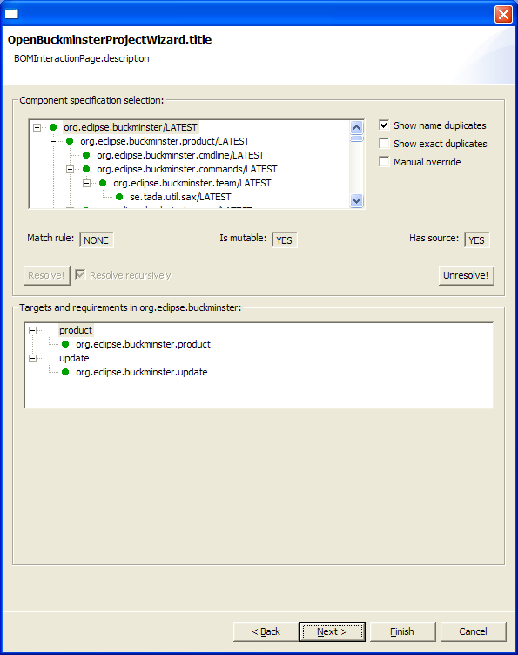
Buckminster in action – sample scenario (4)
The wizard has walked the entire depency tree (in this case about 60 components required) and made default selections.
  Each component can be resolved ’by hand’ if desired
  Many components are fulfilled by the running Eclipse instance

Slide 31
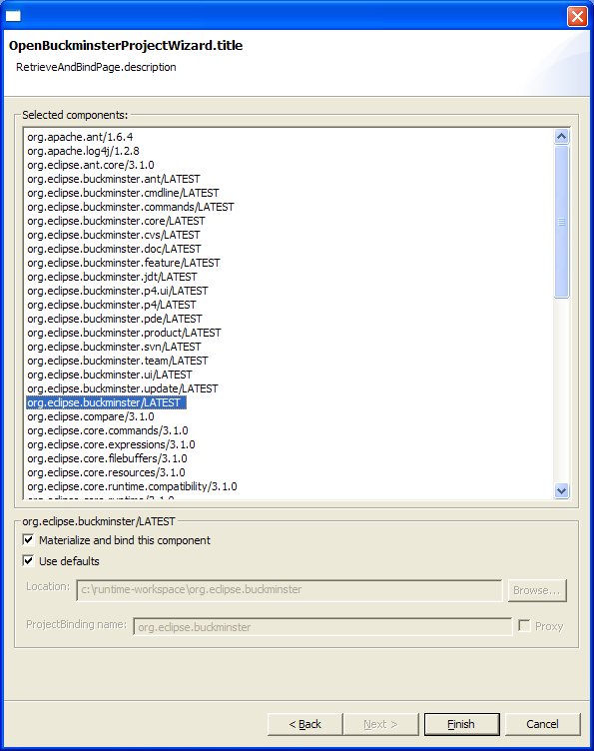
Buckminster in action – sample scenario (5)
The final step is to ’materialize and bind’
  I.e. download code from respective repository and make it visible to Eclipse as native ’projects’
  Again, most components are fulfilled by the running Eclipse instance itself, thus no materialize/bind required

Slide 32
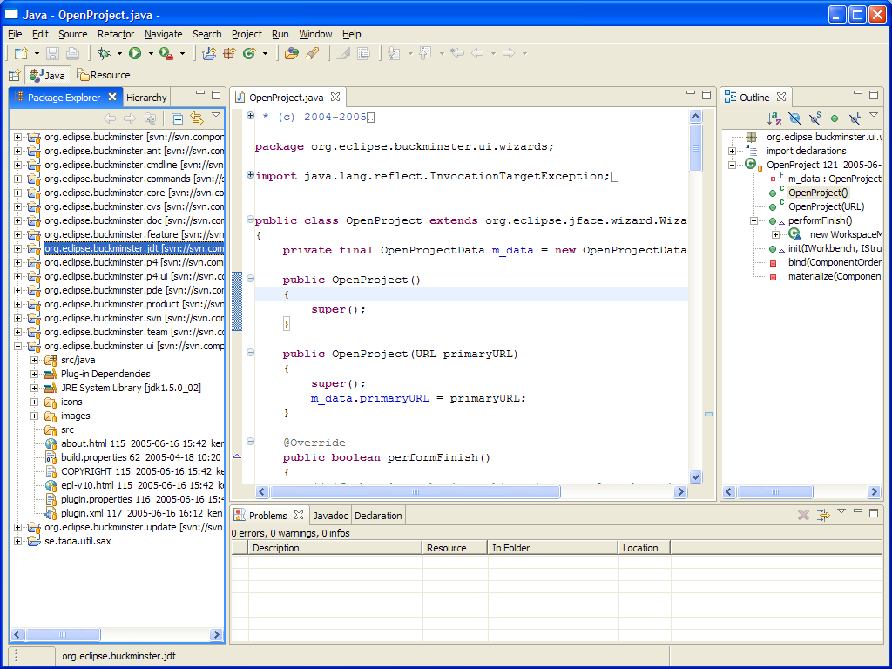
Buckminster in action – sample scenario (6)
The required components are now ready for use

Slide 33
Thank You
Please visit:
http://www.eclipse.org/buckminster

